Slide 1
The Persian Empire

Slide 2
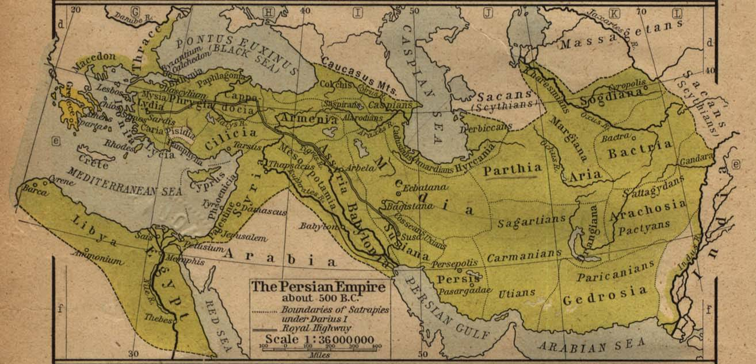
Geography
Extended from the North of the Caspian Sea to the South of the Persian
Located in modern day Iraq, Syria, Turkey, Jordan, Israel, Afghanistan, and Pakistan
Had the Euphrates, Tigris, and Indus River
The land was fertile
The climate was hot and dry

Slide 3
Persian Empire Start
The Persians had over thrown the Assyrians and started to build an empire
The first king was Cyrus
They started expanded their empire by defeating neighboring countries

Slide 4
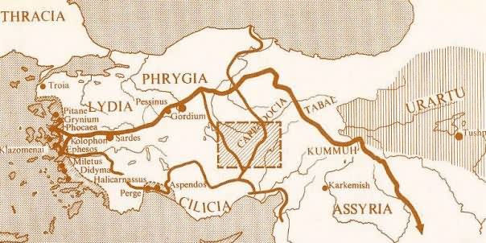
Royal Road
Ran from Susa in Persia to Sardis in Anatolia and was 1,677 miles
Helped unity the empire, was a mailing system, promoted trade and businesses
Allowed the empire to expand and maintain control of people and places
Helped improve communication

Slide 5
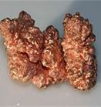
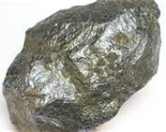
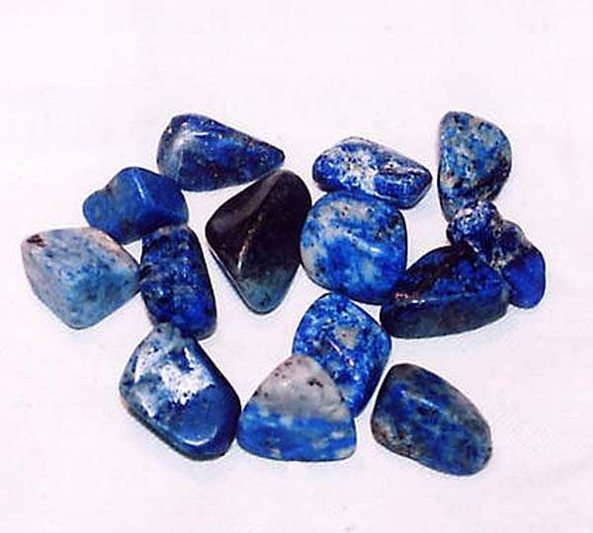
Trade
Minerals – copper, lead, gold , silver, and blue lapis lazuli
Used the Royal Road for transportation
They invented the first coin which promoted trade

Slide 6
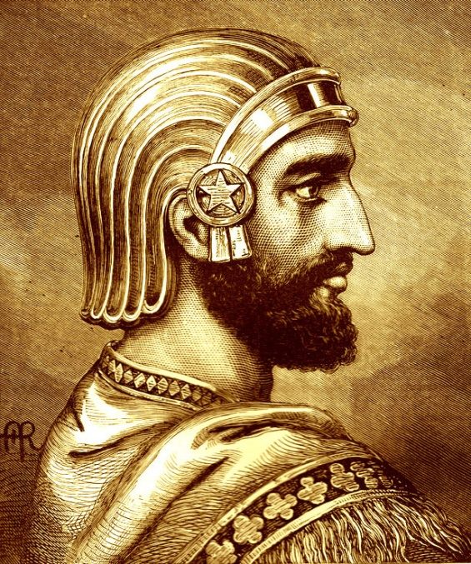
Cyrus
Born around 590 B.C. and died in 530 B.C.
A military genius
Had control of the empire from the Indus River to Anatolia
Instead of having his army destroy the cities he conquered, he would have them march in there so Cyrus could pray because he believed in honoring local customs and religions

Slide 7
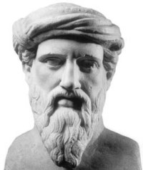
Cambyses
He was Cyrus’s son and was named after his grandfather
Only ruled for 8 years until he died in 522 B.C.
He scorned the Egyptian religion and had all images of Egyptian gods burned

Slide 8
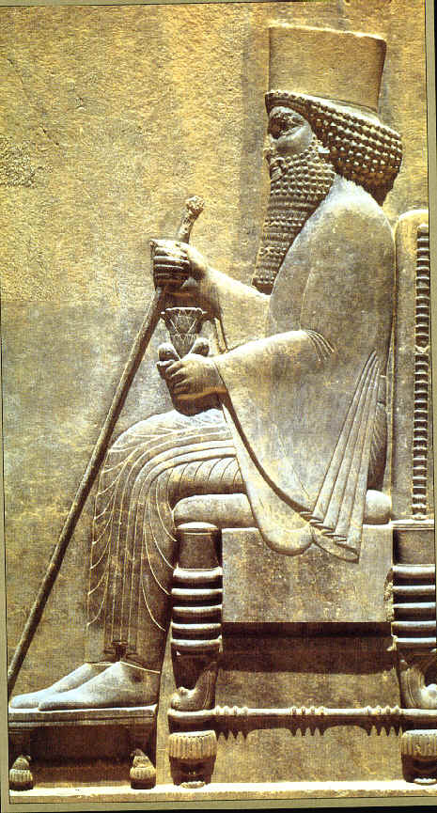
Darius
Started out as Cambyses’s bodyguard
The Ten Thousand Immortals helped him seize the thrown around 522 B.C
He spent a couple years putting down revolts and establishing a well-organized and efficient administration
He sent his armies to present-day Afghanistan and then down into the river valleys of India
After he was done conquering other counties, then empire expanded to 2,500 miles

Slide 9
Provinces and Satraps
Darius divided his sprawling empire into 20 provinces
He installed a governor called a satrap, who ruled locally for each province
He also appointed a military leader and a tax collector for each of the provinces
To ensure the loyalty of the officials, he sent out inspectors known as the “Kings Eyes and Ears”

